Slide 1
Lesson 6 Data Sharing on FPGA
Parallel Loop Execution
Shared Resources
Variables
Memory Items
Race Conditions
FPGA FIFOs
Comparison of Data Sharing Methods
Notes:
Lesson Objectives:
Identify different mechanisms to pass or share data between parallel loops and note at least one task suitable for each.
Implement a data sharing mechanism within a VI.
Understand why the Timed Out? output of a FIFO Read/Write is important.
Identify which mechanism is used to pass streamed and scanned data.
NOTE: Before starting this lesson, start compiling FPGA FIFOs.lvproj so that it will be ready when you reach the demonstration for this lesson. FPGA FIFOs.lvproj can be found at <Exercises>\Demonstrations\FIFO Bucket\.

Slide 2
A. Parallel Loop Execution
Graphical programming promotes parallel code architectures
LabVIEW FPGA implements true parallel execution

Slide 3
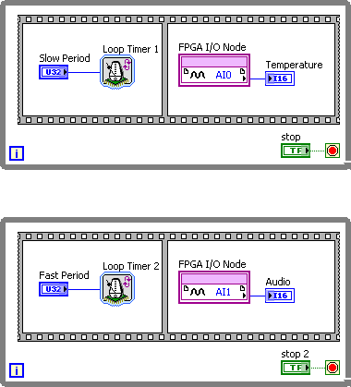
Parallel Loops with Different Sampling Rates
Notes:
The loops shown run in parallel because there are no shared resources between the two loops.
Parallel operations are a very powerful concept in current computer architecture. In a standard processor-based configuration, parallel operations are not truly parallel. In processor-based architectures, programs running on the processor are sliced into many fragments and are interleaved with code fragments of other processes. The operating system then decides which processes are the most important and schedules the fragments of code accordingly.

Slide 4
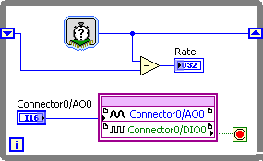
Loop Rate Limitation – Longest Path
AO takes ~35 ticks, DI takes 1 tick (HW Specific)
DI limited by AO when in same loop
38 Ticks
Notes:
Another advantage of running code in parallel is that some sections of code can run faster than other sections. As shown in the figure above, one set of code in a loop can severely limit the speed of another piece of code. In this application, the analog output runs 35 times slower than the digital input. This can become particularly critical if the code were arranged such that the digital line corresponded to an emergency stop switch and the recognition of the response had to happen immediately.

Slide 5
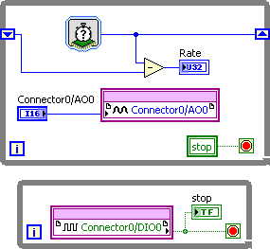
Loop Rate Limitation – Longest Path (continued)
38 Ticks
AO takes ~35 ticks, DI takes 1 tick (HW Specific)
Separate functions to allow DI to run independent of AO
This allows you to sample DI 10 times faster by using a separate loop
4 Ticks
Notes:
In the figure above, the code from the previous figure is divided into two parallel operations. The top loop runs at the same analog output-limited rate of about 1 MHz. However, the code in the bottom loop can run at a rate of 10 MHz, or 10 times faster. Often, when code runs too slowly you can separate the code into parallel operations to prevent unrelated processes from interfering with each other.

Slide 6
Sharing Data Between Parallel Loops
What if you want to pass data from one loop to another?
Since loops are executing in parallel, you cannot use a wire to pass data
Need access to a resource that can be shared by multiple processes

Slide 7
B. Shared Resources
Shared Resource – Any resource that is accessed by multiple objects in an FPGA VI
Digital outputs on most targets
Analog inputs on most targets
Analog output on most targets
Digital inputs on some targets
Memories
FIFOs
Non-reentrant subVIs
Local and global variables
Notes:
The following list shows some components that are considered shared resources:
Digital outputs on most targets
Analog inputs on most targets
Analog output on most targets
Memory and FIFOs
Non-reentrant VIs – Discussed in Lesson 10
Local and global variables – We are only going to discuss local variables in this course.
Digital inputs on some targets (such as C Series modules with more than 8 inputs)
Some LabVIEW FPGA Module applications contain shared resources that are accessed by multiple objects, such as functions or subVIs, in an FPGA VI. Possible shared resources include digital output lines, analog lines, memory items, FIFOs, the interrupt line, local and global variables, and non-reentrant subVIs. Each shared resource contains one or more resource interfaces. A resource interface communicates between objects and shared resources. Resource contention occurs when you include two or more objects on the FPGA VI block diagram that simultaneously request access to the same shared resource through the same resource interface.
For more details view the LabVIEW Help Topic: Managing Shared Resources (FPGA Module)

Slide 8
B. Shared Resources
Before a task can begin using a shared resource, it must wait until the resource is free.
Task 1
Shared
Resource
Task 2
Running
Waiting
After Task 1 finishes, Task 2 can proceed.
Task 1
Shared
Resource
Task 2
Waiting
Running
Notes:
B. Shared Resources
Sharing resources between two different tasks or loops can affect the deterministic execution of the tasks, even when they are in parallel. Resources that may only be accessed by one task at a time can prevent code from executing independently and are referred to as shared resources.
As shown above, Task 1 runs and accesses a shared resource that can be accessed by only one task at a time. Task 2 must wait until Task 1 releases the resource before accessing it. After Task 1 finishes, Task 2 can access the shared resource and execute while Task 1 waits for the shared resource to be free.
Using shared resources causes jitter within the application. To maximize the determinism of our VI, we need to avoid shared resources.

Slide 9
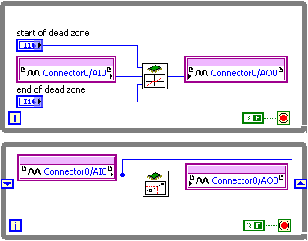
Shared Resources Example
Notes:
Identify the shared resources above.
Both the analog input and the analog output are shared between the two loops.

Slide 10
C. Variables
Variables are block diagram elements that allow you to access or store data in the flip-flops of the FPGA
Store only the latest data you write to it
Good choice if you don’t need every value you acquire
Do not need extra code to discard unused values
Two types of variables on FPGA
Local – Accessible only by a single VI
Global – Accessible by any VI running on the FPGA target
Notes:
Global variables are outside of the scope of this course. For more information about global variables, please refer to the Global Variables topic of the LabVIEW Help.

Slide 11
Local Variables
Store data in front panel controls and indicators
Accessible only by a single VI
Use to maintain data separately for separate re-entrant subVIs
Create by right-clicking on a control or indicator on the block diagram and selecting Create»Local Variable
If you use this approach, you may find yourself creating controls and indicators only for data sharing within the VI they are on. Create a coding convention to help you distinguish such controls and indicators from those that meant for passing data in and out of VIs

Slide 12
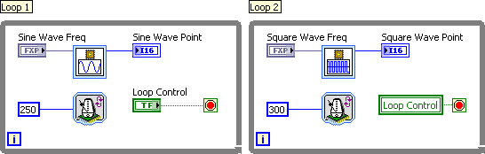
Local Variable Example
Share data between parallel loops running in the same FPGA VI

Slide 13
D. Memory Items
Similar to variables in that only the most recent data is stored
Data can be stored in FPGA memory
Allocate an address or block of addresses
Can use all available memory on the FPGA
Use of block memory consumes relatively few logic resources
Unlike a fixed-size array
Caveats
Does not include extra logic to ensure data integrity across clock domains

Slide 14
Memory Item Usage
Useful if you do not need every data value that you acquire
If you need every data value, FIFOs are a better option
No need to discard old values
Two options for creation
Target-Scoped
VI-Defined
Notes:
If you do need every data point, then you should use a FIFO instead (Section E).
When using a memory item, data is overwritten on subsequent writes, so no additional code is needed to remove the value before another write can occur.

Slide 15
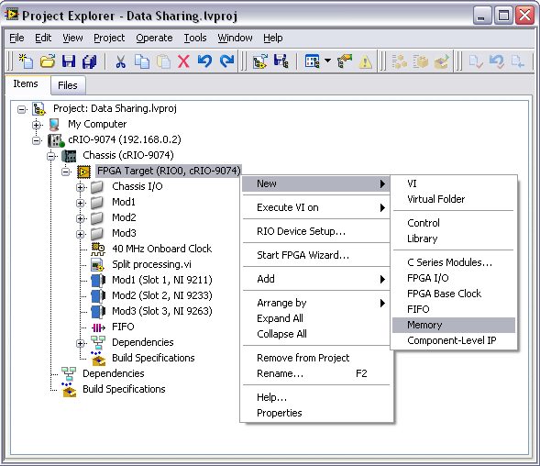
Target-Scoped Memory Item
Accessible by any VI running on the FPGA target
Use to store data that is accessed by multiple VIs
Creation
Right-click on FPGA Target
Select New»Memory
Launches Memory Properties Dialog Box

Slide 16
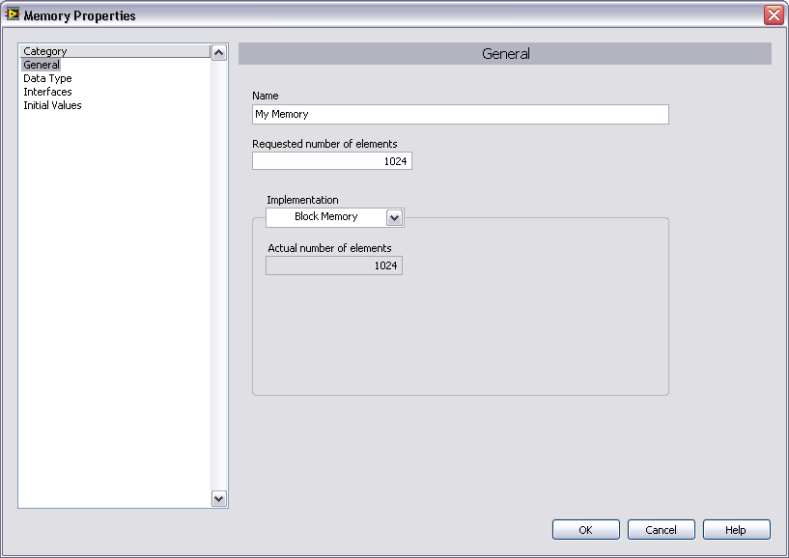
Memory Properties Dialog Box – General Page
Notes:
Requested Number of Elements – The number of elements the memory item can hold. The actual memory usage, in bytes, depends on the number of elements and the data type that is selected.
Implementation – Specifies how the FPGA stores the memory item
Look-Up Table – Stores the memory item in look-up tables available on the FPGA.
Block Memory (default value) – Stores the memory item using embedded blocks of memory on the FPGA.
DRAM –memory external to the FPGAs, available only on some targets.

Slide 17
Memory Items – Implementation
Use block memory when:
You need larger amounts of memory
You do not have enough logic resources available to use look-up tables
Use look-up tables when:
Accessing memory in a single-cycle timed loop and need to read data from memory in the same cycle as the one in which you give the address
The amount of memory needed is smaller than the minimum amount of embedded block memory on the FPGA
You do not have enough free embedded block memory on the FPGA
Notes:
Check hardware documentation for information regarding the amount of block memory available on your FPGA.

Slide 18
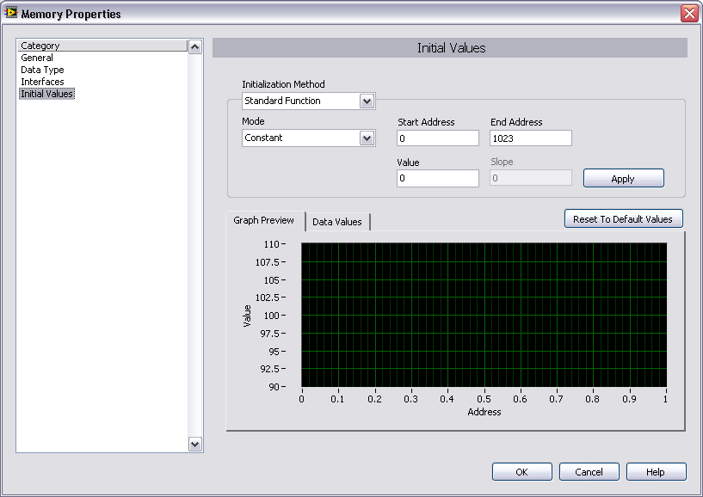
Memory Properties Dialog Box – Initial Values Page
Notes:
Use this page to initialize the memory item that you have created.
Initialization Method – Specify the method you want to use to initialize the memory item
Mode – Specifies the contents with which LabVIEW populates the address interval you select.
Start Address – The low end of the memory item interval you want to populate
End Address – The high end of the memory item interval you want to populate
Value – The constant LabVIEW enters into the memory item if you select Constant from the Mode pull-down menu.
Slope – Slope of the line LabVIEW enters into the memory item if you select Linear from the Mode pull-down menu.
Apply – Displays the initial values in the Graph Preview and Data Value tabs.
Graph Preview – Displays the current contents of the memory item in a waveform graph.
Data Values – Displays the current contents of the memory item.
Reset to Default Values – Resets the contents of the memory item to the default value for the data type contained in the memory item.

Slide 19
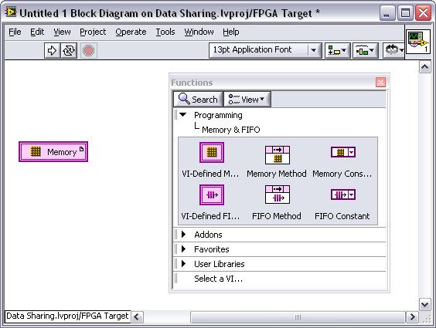
VI-Defined Memory Item
Use for data that you only access from a single VI
Use if maintaining separate data for separate instances of a re-entrant subVI
Creation
Place VI-Defined Memory Configuration Node from Memory & FIFO palette on block diagram
Double-click on node to launch Memory Properties Dialog Box

Slide 20
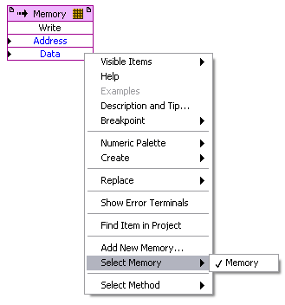
Memory Write and Read
Add Memory Method node from Memory & FIFO palette
Select the memory item to be modified
Right-click node and choose Select Memory
Choose to read from or write to the memory item
Right-click the node and choose Select Method

Slide 21


Memory Write and Read
Address – The location of the data in memory on the FPGA target
Data – The data to be written to or read from the memory on the FPGA target
Add error terminals to perform error handling

Slide 22
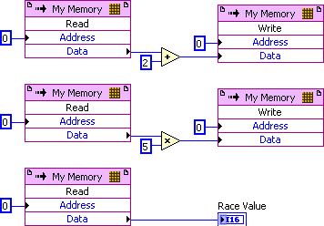
E. Race Conditions
Race conditions can result from accessing a shared resource at multiple locations.
What is the value of the Race Value after executing this VI the first time?
After the second?
After the third?
Notes:
This code has several problems:
It does not control the sequence of operations
There are multiple writers to the memory location
We don’t know the initial value of the memory location

Slide 23
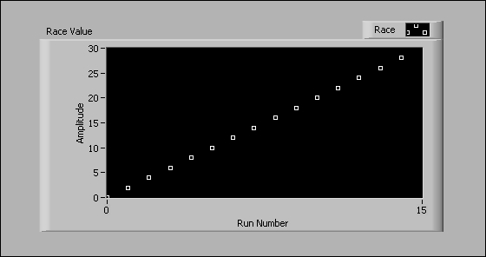
Race Conditions – Possible Result
Notes:
LabVIEW reads the three instances of the memory at address 0 (whose value is 0 in the first execution).
The multiply function executes and writes 0 (5 x 0) to the memory at address 0.
The add function executes and writes 2 (which replaces 0) to the memory at address 0.
The initial value of the memory at address 0 (0) is written to the chart.
In the second execution, LabVIEW again reads the memory at address 0, but this time, the value is 2.
The multiply function executes and writes 10 (5 x 2) to the memory at address 0.
The add function executes and writes 4 (2 + 2) to the memory at address 0, replacing the previous value of 10.
The initial value of the memory at address 0 (2) is written to the chart.
The code consistently repeated the above execution sequence 15 times, but that execution sequence is not guaranteed.

Slide 24
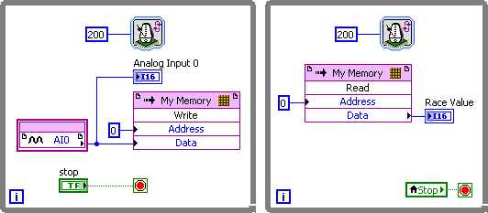
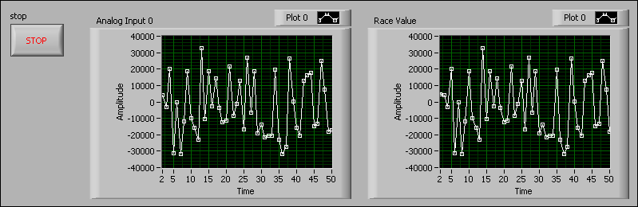
Parallel Loops – Write and Read at Same Rate

Slide 25
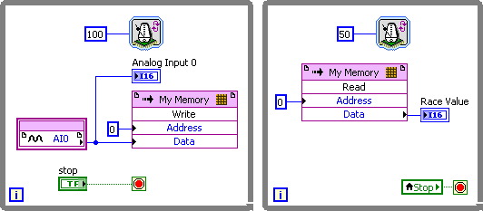
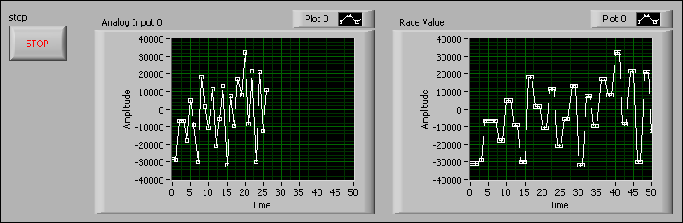
Parallel Loops – Oversampling
Notes:
Oversampling is sampling at a rate at least twice the highest frequency component of interest in the signal and is usually desired.
Oversampling occurs when acquiring data from slower hardware (analog input signals, thermocouples, etc.) and then processing on faster hardware (FPGA).
Oversampling is often necessary when trying to capture fast edges, transients, and one-time events.

Slide 26

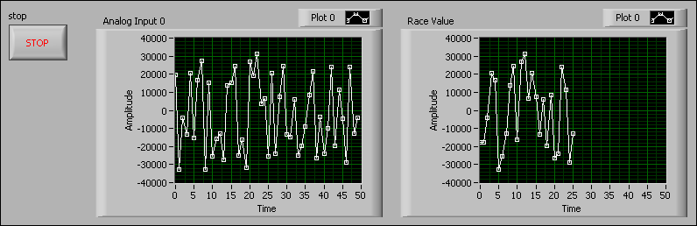
Parallel Loops - Undersampling
Notes:
Undersampling is essentially sampling too slowly, or sampling at a rate below the Nyquist frequency for a particular signal of interest. Undersampling leads to aliasing and the original signal cannot be properly reconstructed. Undersampling occurs when the processing loop loses samples because it is slower than the data acquisition loop.

Slide 27
Avoiding Race Conditions
Control shared resources
Properly sequence instructions
Reduce use of variables
Identify and protect critical sections within your code
Pass data between parallel loops by using FIFOs
Notes:
By default, parallel LabVIEW loops execute independently and in parallel when implemented in FPGA hardware. In order to time loops off of each other, you can affect the execution order or sequence of events so that each task is performed when you want. A structure commonly used for controlling the program flow and synchronizing parallel loops are local FPGA FIFOs.

Slide 28
F. FPGA FIFOs
FIFO – First-in first-out buffer. The first data item written to memory is the first item read and removed from memory.
Target-Scoped – A single FIFO transfers data between loops on multiple VIs running on the same target
VI-Scoped – A single FIFO transfers data between multiple loops in the same VI
Notes:
FPGA FIFO is similar to a fixed length queue (LabVIEW Core 2 course).

Slide 29
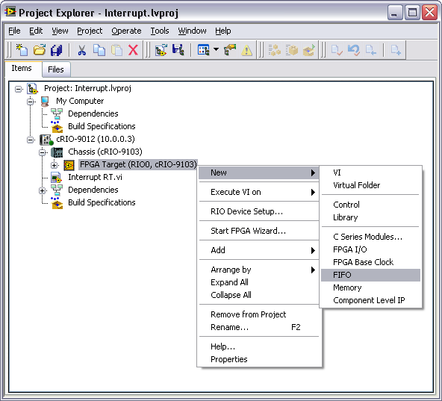
Target-Scoped FIFOs
Appear under the FPGA Target in the Project Explorer Window
Use to store data that you need to access from multiple VIs
Create Target-Scoped FIFOs From the Project Explorer window

Slide 30
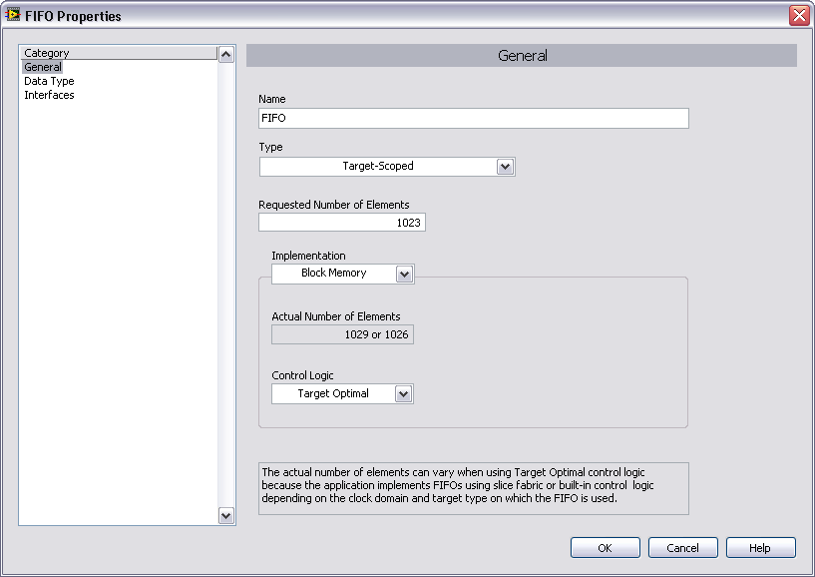
FIFO Properties Dialog Box
Notes:
Note: The Type pull-down does not appear if you have created a VI-defined FIFO.

Slide 31
FIFO – Number of Elements
Number of elements FIFO can hold
Maximum depends on the Implementation that has been selected and the amount of space available on the FPGA for the implementation
You request the number of elements based on the needs of the application. LabVIEW specifies the actual number of elements. If the actual number is greater than the requested number, the difference is due to technical constraints.
Notes:
If the value specified is too large, The FPGA will fail to compile.
For DMA FIFOs, Number of Elements specifies the size, in elements, of the FPGA part of the FIFO

Slide 32
FIFO – Implementation
Flip-Flops – Use gates on the FPGA to provide the fastest performance. Recommended only for very small FIFOs <100 bytes.
Look-up Table – Store data in look-up tables available on the FPGA (2 per slice). Recommended only for small FIFOs < 300 bytes.
Block Memory – Store data in block memory to preserve FPGA gates and LUTs for your VI.
Notes:
The Memory Type property specifies the type of storage the FIFO uses on the FPGA. This option is disabled if you select DMA from the Type pull-down menu. DMA FIFOs will be discussed in Lesson 9, DMA Data Transfers.
Block memory available:
80 kB on a 1M gate FPGA
192 kB on a 3M gate FPGA
You cannot use FIFOs with a Memory Type of Flip-Flops or Lookup Table across multiple clock domains. If you select the Block Memory option, you might not be able to read data in a Target-Scoped FIFO or VI-Scoped FIFO until up to six clock cycles after you write the data to the FIFO. Use the Timed Out? output of the FIFO Read or FIFO Write function to determine when the data is ready.

Slide 33
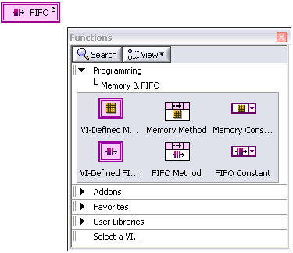
VI-Scoped FIFOs
Create VI-Scoped FIFOs using the VI-Defined Configuration Node from the Memory & FIFO Palette
Right-click on the VI-Defined FIFO Configuration Node and select Configure to launch the FIFO Properties dialog box

Slide 34
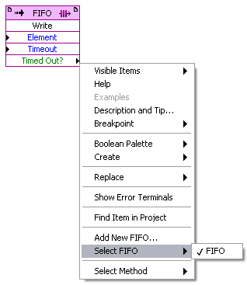
FPGA FIFO Write and Read
Place a FIFO Method from the Memory & FIFO palette
Right-click the object and choose Select Method
Choose Write or Read
Right-click the object and choose Select FIFO
Associates node with a defined FIFO

Slide 35


FPGA FIFO Write and Read
Element –The data element to written or read
Timeout – Sets number of ticks the function waits for space if the FIFO is full.
Timed Out? – True if attempt to write failed. Does not overwrite or add new element.
FIFO transfer may be lossy if write times out
Notes:
The default Timeout value is 0, resulting in no wait.
If you set the Timeout value to -1, then the node will wait indefinitely.
FIFO write can fail if the FIFO was full at the time that the FIFO Write method was called.

Slide 36
FIFO Overflow and Underflow
Overflow – Write loop executing faster than read loop
FIFO is filled and the FIFO Write method times out
Data is not written to the FIFO until space is available in the FIFO
Space can be created by reading data or resetting the FIFO
Data is lost until space is made available.
Underflow – Write loop executing slower than read loop
FIFO is empty and the FIFO Read method times out

Slide 37
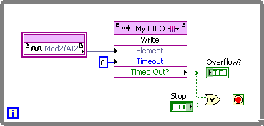
Handling FIFO Overflow and Underflow
Method for handling overflow/underflow depends on importance of lossless transfer
Latch Timed Out? output of read/write method so that operator can see if a timeout ever occurred
Use Timed Out? as a condition for termination of loop execution

Slide 38
Demonstration – FIFO Bucket
Test how a FIFO works by reading and writing data and observing the effect on the FIFO status.
Notes:
Open FPGA FIFOs.lvproj, located at <Exercises>\Demonstrations\FIFO Bucket\
Run the VI and set the Write Boolean control to True. Allow Bucket to fill and point out the FIFO Full indicator status. This corresponds to an overflow condition.
Set the Read Boolean control to True and the Write Boolean control to False. Allow Bucket to empty and point out the status of the FIFO Empty indicator. This corresponds to an underflow condition.
This VI demonstrates how elements are written to and read from a Target-Scoped FIFO on FPGA. Press Write to write elements to the FPGA FIFO and Read to read elements off of the FPGA FIFO. The bucket indicator shows how many elements are in FPGA FIFO.

Slide 39


Get Number of Elements to Read/Write
Get Number of Elements to Read
Returns the number of elements remaining to be read
Get Number of Elements to Write
Returns the number of empty elements remaining in the FIFO
These methods can be used to avoid underflow/overflow conditions by monitoring the status of the FIFO.

Slide 40
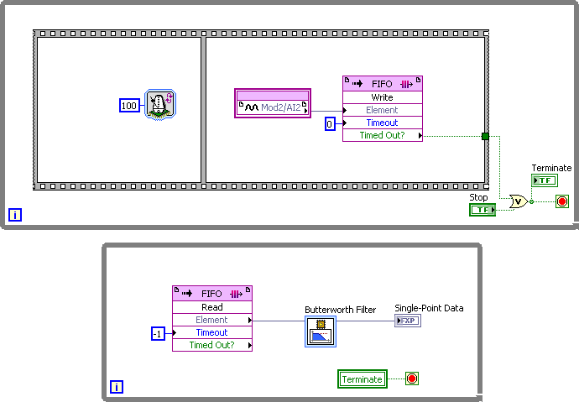
Separate I/O and Data Processing
Top loop acquires data and writes to FIFO
Bottom loop reads FIFO and processes data
Results in faster I/O
Notes:
This is an instance of where a FIFO would be useful.

Slide 41

Clear Method
FIFOs retain data if the FPGA is stopped and restarted.
Use the Clear Method to empty a target- or VI-scoped FIFO
Place FIFO Method node
Right-click on object and choose Select Method»Clear

Slide 42
Exercise 6-1 Accelerometer Threshold
Create a VI on the FPGA with parallel loops that pass data using an FPGA FIFO.
Notes:
Prep discussion:
Create a VI on the FPGA with parallel loops that pass data using an FPGA FIFO
You will use a target-scoped FIFO to pass data between an acquisition loop and a processing loop.
If overflow occurs during a write operation, use a local variable to halt execution of all three loops.
You will perform a conditional digital write to a the FPGA LED if the threshold value is exceeded.

Slide 43
Exercise 6-1 Accelerometer Threshold
Why is it important to configure the FIFO data type to match the data that you will be writing to it?
Could this application have been developed using a VI-defined FIFO?
What is the purpose of the FIFO Clear method in this exercise?
Notes:
If you do not pay attention to the data type that is generated by the NI 9233, or any other data that will be written to the FIFO, then your application may have coercion dots. Each coercion dot results in an extra copy of the data being stored, which requires the use of additional FPGA resources.
Yes, a VI-defined FIFO could have been used since we are not accessing the FIFO in any subVIs. However, if you want to use subVIs to handle your FIFO functions, then you MUST use a target-scoped FIFO to make the data available to every VI that executes on the target.
The FIFO Clear method is used to clear data from the FIFO before writing or reading data. This ensures that data generated in previous executions of the VI will no longer reside in the FIFO. This can be especially important if an overflow condition occurred in the previous execution, since the FIFO could still be full.

Slide 44
G. Comparison of Data Sharing Methods
Transfer Method | FPGA Resource | Lossy? | Common Use
Variables | Logic | Yes | Control, Simulation
Memory Items | Memory | Yes | Control, Simulation, Variable sized data
Flip-Flop FIFOs | Logic | No | Datalogging (FIFOs smaller than 100 bytes)
Look-Up Table FIFOs | Logic | No | Datalogging (FIFOs smaller than 300 bytes)
Block Memory FIFOs | Memory and Logic | No | Datalogging (FIFOs 300 bytes or larger)

Slide 45
Summary—Quiz
Which of the following is NOT a method for passing data between parallel loops on an FPGA?
Local variable
Memory item
FIFO
A wire containing the data

Slide 46
Summary—Quiz Answer
Which of the following is NOT a method for passing data between parallel loops on an FPGA?
Local variable
Memory item
FIFO
A wire containing the data
Notes:
Answer: D. A wire containing the data. A wire would cause the loops to execute in sequence instead of in parallel. To pass data between loops, you should use a local or global variable, memory item, or FIFO, depending on the amount of data that you want to transfer, what resources you want to allocate to the transfer, and whether or not you are concerned with transferring all data that is acquired.

Slide 47
Summary—Quiz
Which of the following may result if an FPGA VI with a FIFO Read or Write does not monitor the Timed Out? output, assuming that the Timeout is not -1 (infinite)? (Select all answers that apply)
Attempts to write when there is no room in the FIFO may go undetected
Attempts to read from an empty FIFO may be misinterpreted as having produces valid data
The FIFO may reset itself automatically
LabVIEW will report a code generation error
None of the above

Slide 48
Summary—Quiz Answer
Which of the following may result if an FPGA VI with a FIFO Read or Write does not monitor the Timed Out? output, assuming that the Timeout is not -1 (infinite)? (Select all answers that apply)
Attempts to write when there is no room in the FIFO may go undetected
Attempts to read from an empty FIFO may be misinterpreted as having produces valid data
The FIFO may reset itself automatically
LabVIEW will report a code generation error
None of the above
Notes:
Answer: A and B

Slide 49
Summary—Quiz
Match each method of FIFO implementation with its recommended usage.
Block Memory
Flip-Flops
Look-Up Table
For FIFOs smaller than 300 bytes
For FIFOs larger than 300 bytes
For FIFOs smaller than 100 bytes

Slide 50
Summary—Quiz
Match each method of FIFO implementation with its recommended usage.
Block Memory
Flip-Flops
Look-Up Table
For FIFOs smaller than 300 bytes
For FIFOs larger than 300 bytes
For FIFOs smaller than 100 bytes
Notes:
Answers:
Block Memory – B. Recommended for FIFOs larger than 300 bytes. This implementation uses FPGA memory to store data which only has a minor impact on the amount of logic available for the rest of the FPGA application.
Flip-Flops – C. Recommended for FIFOs smaller than 100 bytes. This implementation results in the fastest performance, but is costly in terms of the logic that is used.
Look-Up Table – A. Recommended for FIFOs smaller than 300 bytes. This implementation makes use of available look-up tables in the logic section of the FPGA.

